Slide 1
INFO-H502 Project

Slide 2
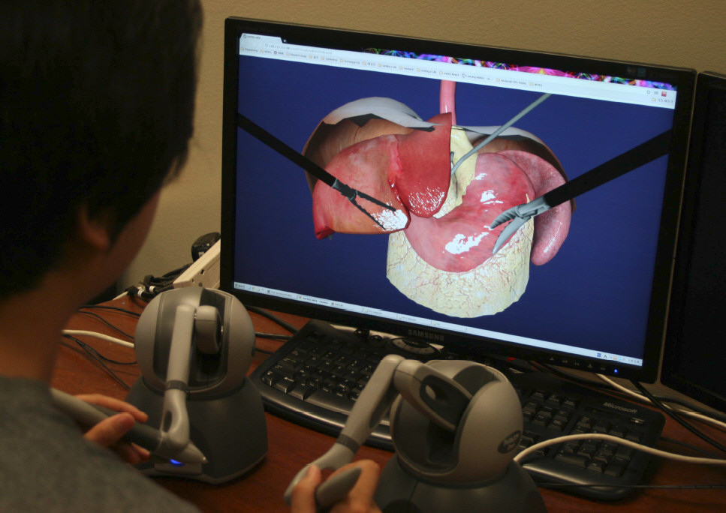
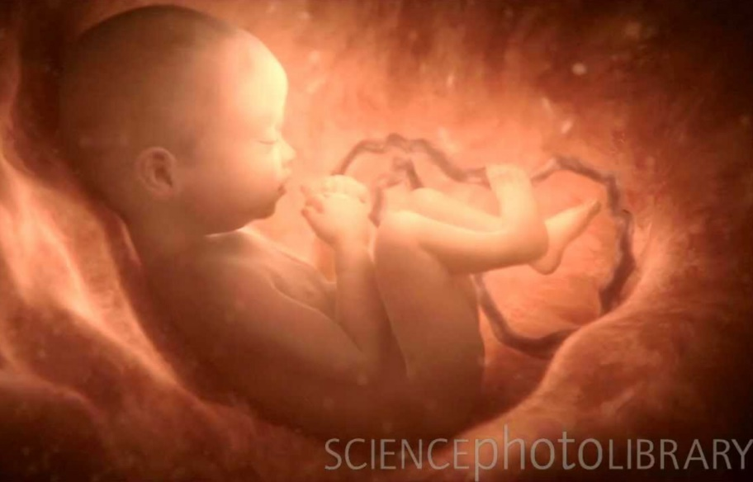
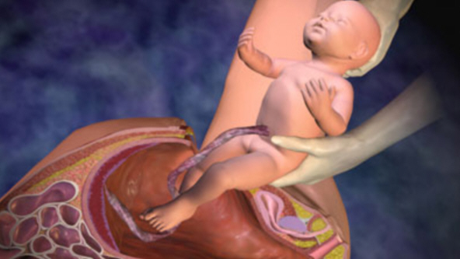
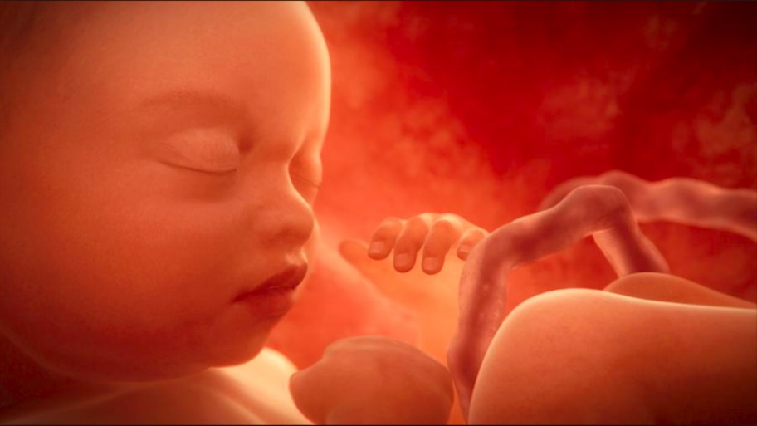
Biomed students
First steps towards an anatomical simulator
Bezier/NURBS surface elastic tissue
Environmental map (baby is slightly reflective)
Glowing effect (wax/marble effect)

Slide 3
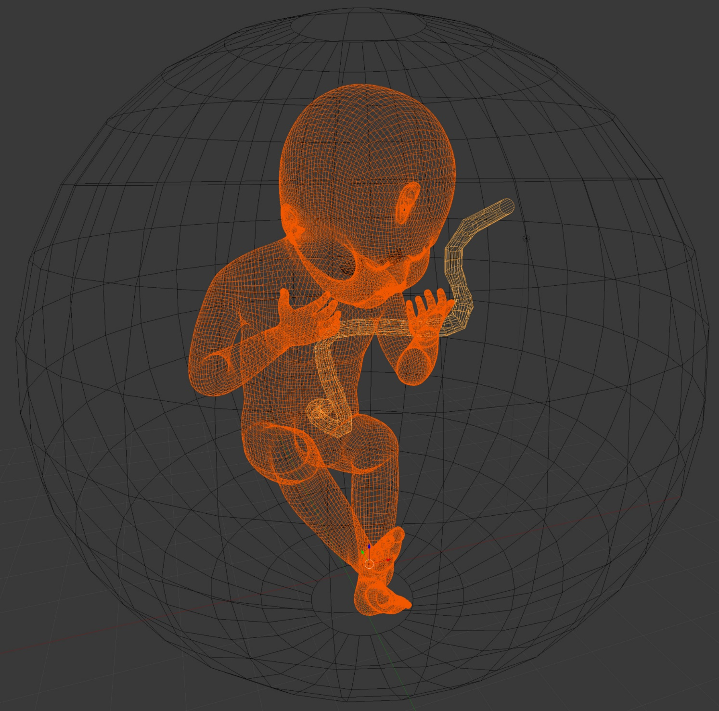
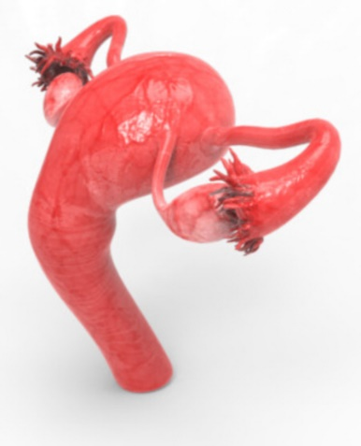
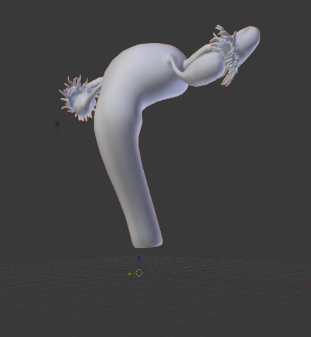
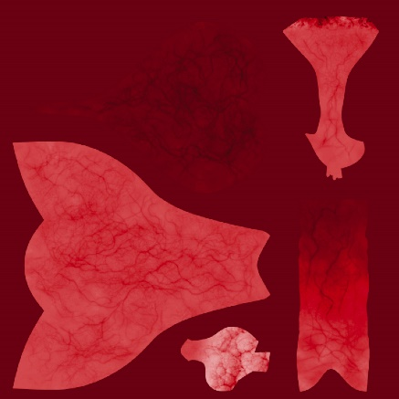
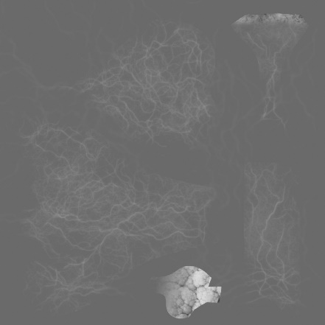
3D model
Sphere = NURBS
3D mesh
Open the sphere
2D texture
Bump texture
6 white light sources
Spherical map

Slide 4
Functions
Score up to 16:
X, x, Y, y, Z, z = turning the baby around its axes (= Rodriguez)
L, l, R, r, U, u, D, d = move the camera left/right, up/Down
I, O = move camera forward/back, zoon-In/zoom-Out
All above movements with the mouse
Sphere has bump map (cf. Chapter 19 of Fore June’s book)
Baby has a wax/marble effect
Baby and sphere have shininess (= specularity in GLSL)
Look inside the sphere without having to cut the sphere (cf. like environmental map)
Look from outside the sphere when sphere is cut
Provide elastic cuts (cf. Bezier, NURBS)
A = Animation, cutting the sphere, gradually open it, rotate the baby in a position such that its head passes through the cut + give a translation to extract the baby
Program as much as possible in OpenGL 3/4 (re-implement deprecated functions e.g. Rodriguez, do lighting/shading in GLSL)
Work in phases, e.g. CubeMap with low-resolution baby first, reuse example code (drop unnecessary portions), modify GLSL examples, change one function at a time, etc.
No collision detection needed, i.e. take proper action that the baby passes neatly through the cut.
No raytracing

Slide 5
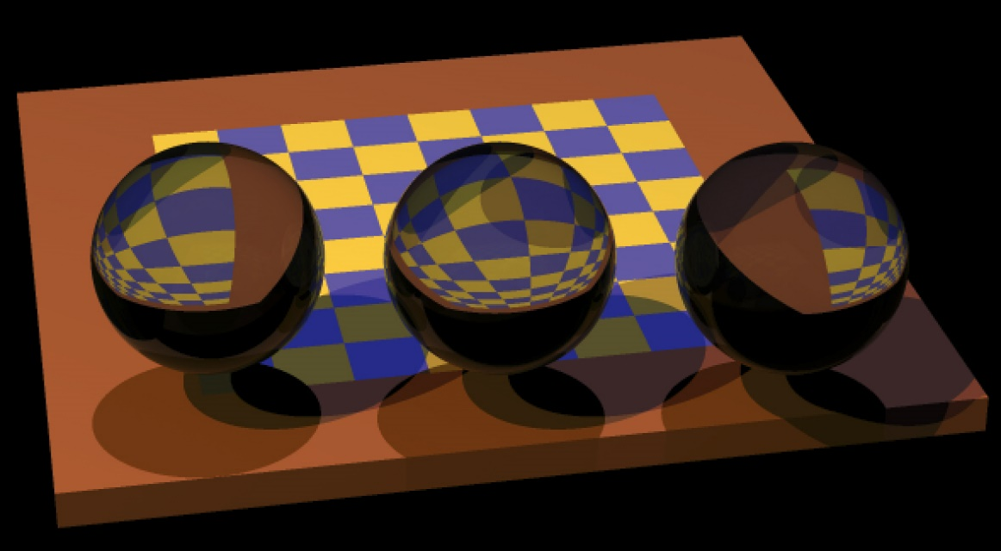
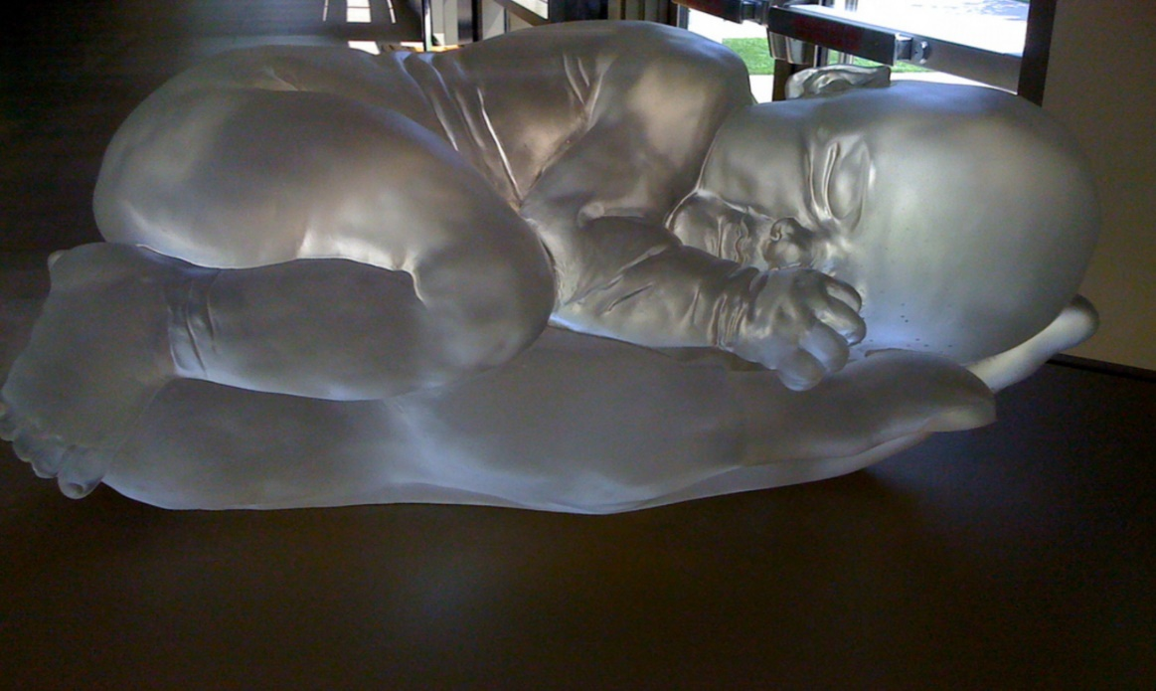
Raytracing and physics engine
Score +2:
Replace 3 spheres by baby (low resolution) lying on its back
Baby is now glass
Replace half of the checkerboard by uterus reddish texture (without bump map)
Score +1++:
Drop a tissue on the baby and use a physics engine (collision detection etc) to see its deformation
Score +1++:
Previous + raytrace this full scene
Photonics student:
+3 possible without physics engine, but with impressive raytracing results, i.e. finetuned parameters (including mat material) to come close to an effect as in the left picture

Slide 6
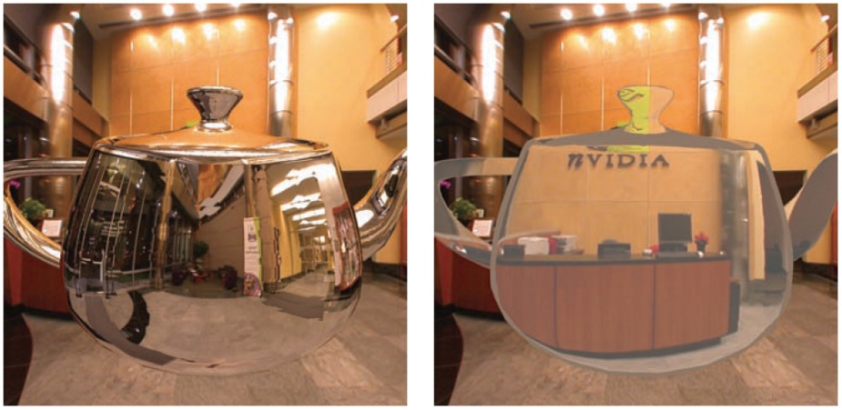
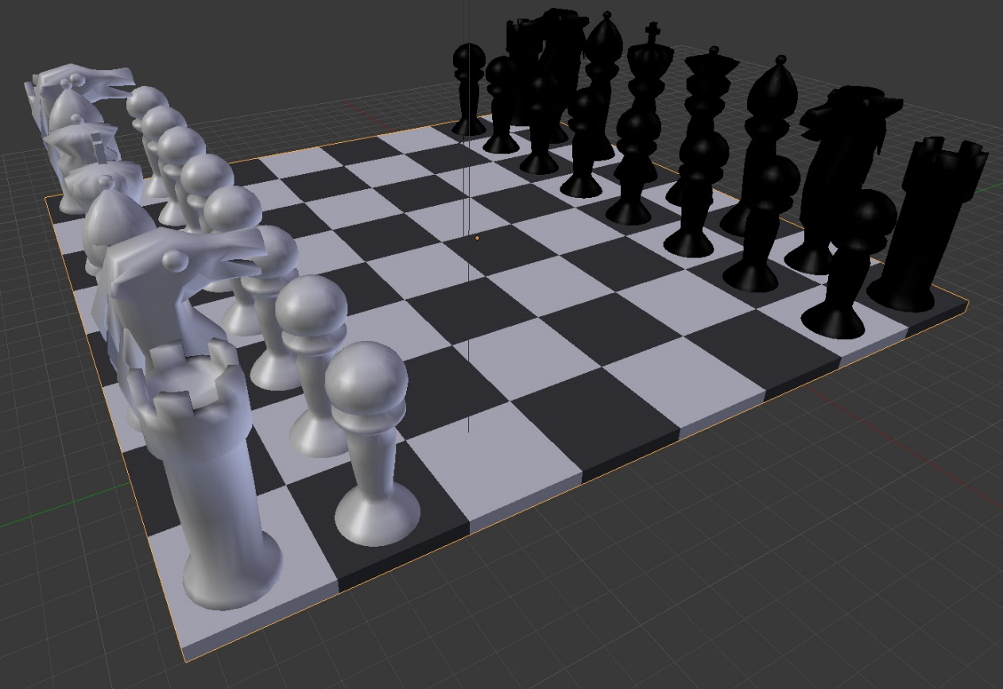

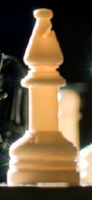
Computer Science students
Score up to 16:
Full hierarchy of objects
+ differentiate (e.g. color) the two players sets
Support reflective, refractive and classical lighting modes in GLSL
Support Knights moves
Look around with the mouse
Implement the Cook-Torrance lighting mode, with very anisotropic characteristics
Glowing effect
(wax/marble effect)
Bump map the checkerboard
All lighting parameters should be easily changed

Slide 7
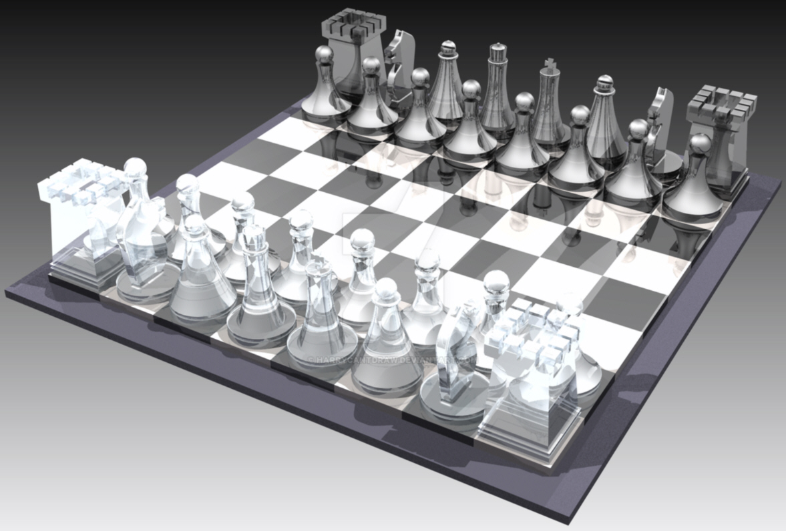
Raytracing and physics engine
Score +2:
Raytracing with glass chess pieces (no bump mapping)
Score +2:
Bowling ball colliding with the chess pieces (without raytracing), e.g. Bullet Physics engine
Since VUB students have only 4 credits instead of 5, same scores can be obtained with just a couple of pieces on the checkerboard

Slide 8
To be provided 2 weeks before the exam
(email to gauthier.lafruit@ulb.ac.be)
Code and executables
Report (in pdf and/or Microsoft doc):
  Make screen shots of the results (multiple screen shots or even movie capture in case of an animation)
  Exercises: very shortly answer the questions
  Project: a bit more explanations on the approach and code structure
Be visual !!

